Slide 1
Soil and Water Conservation District Commissioner Enrichment
Conservation Districts of Iowa
Annual Conference
August 28-29, 2023

Slide 2
Agenda
SWCDs — A Long Legacy with Serious Responsibilities
The Story of Soil & Water Conservation
Iowa Code 161A—Enabling and Empowering Legislation
Duties & Responsibilities of Commissioners
Rising to the Conservation Challenge
Key Partnership — A Three-legged Stool
Conservation Districts of Iowa — Commissioner’s Association
National Partner — National Association of Conservation Districts

Slide 3
SWCDs – A Long Legacy
“I consider the soil conservation districts movement one of the most important developments in the whole history of agriculture.”
Hugh Hammond Bennett, pioneer in the field of soil conservation; founded and headed what is now the Natural Resources Conservation Service (NRCS).

Slide 4
State of Iowa - Oath of Office
I do solemnly swear that I will support the Constitution of the United States and the Constitution of the State of Iowa, and that I will faithfully and impartially, to the best of my ability, discharge all the duties of the office in ____________________________ (name of township, city, county, district, or state), as now or hereafter required by law.
Signature of Official:
Date:
State of Iowa County of _______________
This instrument was acknowledged before me on: _______ By: Date
Print Name of Person
X
Signature of Notarial Officer Title (and Rank)
Name of Official: Office:

Slide 5
Story of Soil & Water Conservation Cost Share for Conservation
1950: Iowa Legislature made available first tax money
for soil conservation work in Iowa
1973: Iowa becomes the first state to appropriate state
cost share funds for conservation
2023: Cost share has been available for 50 years in Iowa
FACTOID: Wade Houser, Polk County Commissioner,
helped write that first cost share bill!

Slide 6
Story of Soil & Water Conservation Iowa Legislation, First in Nation
1971: Legislation
Establishes a soil loss limit
Mandates soil conservation if a complaint is filed and district and others determine soil loss is greater than established limits
75% of mandated cost share be paid by the states cost share appropriations
First law of its kind in the nation
1979: Legislation challenged
Law found valid and constitutional by Iowa Supreme Court

Slide 7
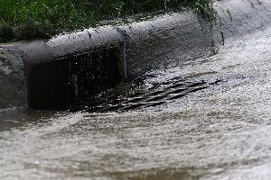
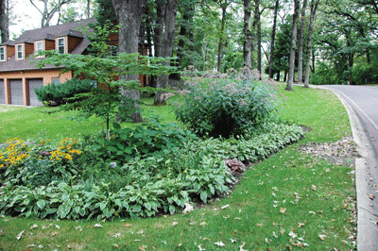
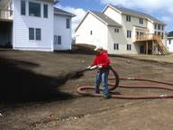
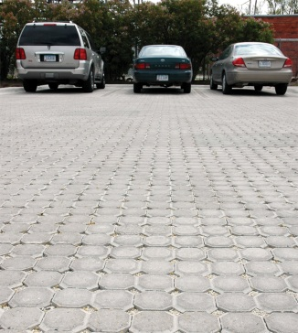
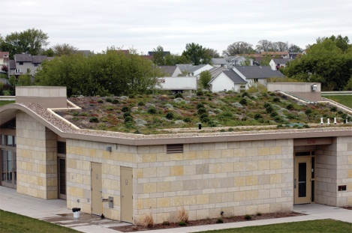
Story of Soil & Water Conservation Urban Conservation in Iowa
1970: Amendment is passed by Iowa Legislature that all cities and towns in Iowa must be included in soil districts and urban residents in the county could vote and could become commissioners as well
1997: NRCS State Conservationist created NRCS Urban Conservationist Position
2000: IDALS creates first Environmental Specialist Position tasked with doing Urban Conservation
2008: Secretary of Agriculture Bill Northey introduces five new Iowa Department of Agriculture and Land Stewardship employees focused on conservation of soil and water in urban areas
2012: $1 million requested by Northey in budget to Governor for Urban Conservation
2013: REAP and WQI rules allow for urban projects
URBAN POLLUTION !
CONSERVATION SOLUTION!

Slide 8
Iowa Code 161A Enabling and Empowering Legislation
Elected nonpartisan official for 4-year term in staggered even numbered years—same as general election
5 elected commissioners per board (SWCD) with power to appoint assistant commissioners
No compensation; reimbursed for actual expenses as funding allows (1M funding)
Protected from personal liability in the discharge of duties under State of Iowa bond
Fiduciary responsibility for public funds
Read this code to understand scope of responsibilities

Slide 9
Conservation District Defined
Conservation Districts are local units of state government established under Iowa law to carry out soil and water programs at the local level
Pay no sales tax, after filing required documentation with vendor
Able to accept donations

Slide 10
Required Five-year Plans
Review 5-year plan annually; renew every five years
Activate the Federal Local Working Group process
Public input into plan development is critical, should include how Watershed Management Authorities fit
District wide plan but should consider individual watersheds, contain achievable goals, and be flexible to account for changing conditions.
NRCS funded a major effort to develop new 5-year plans for all 100 SWCDs. Each district is required to update these plans annually.
Information in plans used to fulfill required reporting for EPA Nonpoint Source Management Plan.

Slide 11
District Annual Work Plan
Develop annual work plan using five-year plan as a starting point
Engage your Local Working Group including Watershed Management Authority groups to seek public input to add to plan
Identify major concerns in your county
Determine your objectives and goals for the year
Analyze all resource data you have available
Explore what activities will help you accomplish your goals
Be flexible, conditions may change
Share your annual plan publicly

Slide 12
2024 Election Year
Need to file petition to run for office
Petition is available from your local elections office or online at Secretary of State website.
Need 25 signatures. Always get more to make sure all signers are valid.
File with local elections office before 69th day which is
AUGUST 28, 2024, by 5:00 p.m.

Slide 13
Duties & Responsibilities Monthly Meeting Responsibilities
Hold monthly meetings; chair sets the agenda
Abide by Iowa Open Meetings Law & Open Records Law
Post notice of meeting/agenda 24 hours in advance
Conduct official business with a required quorum of 3 commissioners
Conduct meetings using standard parliamentary procedures
Maintain complete and accurate meeting minutes
Create and publish an annual report (newsletter), include district financials

Slide 14
Responsibilities & Obligations
Attend Spring Regional Commissioners Meetings
Attend Annual Commissioner’s Conference
Attend Iowa Conservation Partnership Day at the Capitol
Refer to Commissioner’s Handbook on CDI website for information www.cdiowa.org
Be informed of issues impacting your district and conservation in general

Slide 15
January Organizational Meeting
Must convene on first day of January that is not a Sunday or holiday in each odd-numbered year.
Notaries public administers Oath of Office and notarizes certificates provided by local elections office which must be returned
Conservation Assistant, if a notary, can administer the oath
Commissioners elect a chair and vice chair
Chair calls for a motion to appoint Treasurer and Co-treasurer and motion is voted on by commissioners
Chair calls for a motion to appoint Conservation Assistant as Secretary of the Board and motion is voted on by commissioners

Slide 16
January Organizational Meeting (continued)
Chair calls for several motions and commissioners vote on these motions. Motions may include:
Approve the current year’s District Financial Policies which must be initialed per IDALS.
Approve the local District Financial Policies which are usually filed in the district’s policy manual.
Appoint assistant commissioners and describe duties.

Slide 17
January Organizational Meeting (continued)
Chair reviews the Safe Workplace Environment Policy
NRCS District Conservationist reviews the annual mandatory Civil Rights Policy
Commissioners can take the opportunity to review their 5-year plan to recalibrate goals and objectives for the coming year
Discuss pending challenges and opportunities to develop action items to address to begin developing annual plan
Set a date for the annual local district audit of finances

Slide 18
Fiduciary Responsibility
Commissioners are fiduciaries.
A fiduciary is a person or organization that acts on behalf of another person or persons, putting the public interests ahead of their own, with a duty to preserve good faith and trust. Being a fiduciary requires being bound both legally and ethically to act in the other's best interests.
District funds are treated as public funds even though commissioners do not have direct financial authority over grant and practice funds.

Slide 19
Fiduciary Responsibilities (Continued)
Review monthly treasurers' report during board meeting
A motion to approve the treasurer’s report is inappropriate because the report has not been reviewed during the annual district financial review
The proper response is for the Chair to say that ‘the report is received and will be filed for audit.’
Follow your District Financial Policies
Conduct annual self-review of district funds; due by Sept. 30 to IDALS

Slide 20
SWCD Expense Fund (1M)
Annual allotment from IDALS
Pays mileage & expenses for commissioners & assistant commissioners
CDI dues are paid from these funds, also NACD dues. Other association dues affiliated with our mission
Can buy office supplies & pay for printing of publications
Cover meeting & workshop expenses—no food/drinks
More expenses are found in IDALS Policies & Procedures manual. CAs have access. You can, too.

Slide 21
OVERVIEW: District Funds Sources
District funds are public funds
IDALS Financial Specialists available to help
In District Account
1M funds for commissioner expenses
Funds from District fundraising activities (tree sales, equipment rental, donations, etc.) Spend with commissioner discretion according to district policy
Funds from grants such as DNR 319, WPF, WSPF,WIRB & WQI for administration including salary, benefits, education and outreach, supplies, equipment, travel and training, etc. Monthly requests for these funds required
In FARMS (Financial And Resource Management System)
All practices receiving state cost share, DNR 319, WPF, WSPF, WIRB, WQI, no interest and low interest loans
NRCS Systems
(Pro Tracts/Conservation Desktop)
All practices receiving federal cost share, EQIP, CSP, CRP, etc.

Slide 22
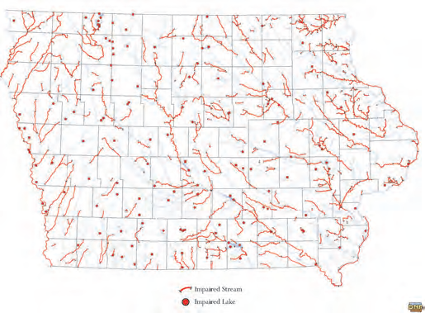
Rising to Changing Challenges
Variable intense weather patterns; more frequent events
Increase in population increases pressure on farmland
Soil losses; diminished water quality
Nearly 600 (56%) of Iowa’s streams, rivers & lakes are impaired or highly polluted, contributing to Dead Zone in Gulf of Mexico
Over 50% of land in Iowa is rented
More and different partners owning land
Increased Congressional funding available—need to hire!!

Slide 23
Rising to the Challenge: Increased Conservation Funding
By 2050 farmers need to raise 30% more food on fewer arable acres globally to feed between 7 to 10 billion people on this planet.
Congress acknowledged this dire need and funded conservation through the
Bi-partisan Infrastructure Law ($1B)
Inflation Reduction Act ($24B)
Funding ends FY31—Sept 30, 2031
Climate Smart Ag ($3.1B)
Regional Conservation Partnership Program (RCPP) ($50M allotted to Iowa to date)

Slide 24
Rising to the Challenge: Soil Health & Water Quality
“If we were truly driven by the need to feed the world, we would be cognizant of the long term need to maintain soil and water resources so that we could sustain our noble intent.”
Dr. Richard Cruse, Agronomy Professor, Iowa State Univ.
Conservation practice funding is available to address both our soil health and water quality issues.
Commissioners need to be vocal advocates to get others to adopt practices that really work.
Soil is the answer. What is the question?
More properly: SOIL HEALTH is the answer.

Slide 25
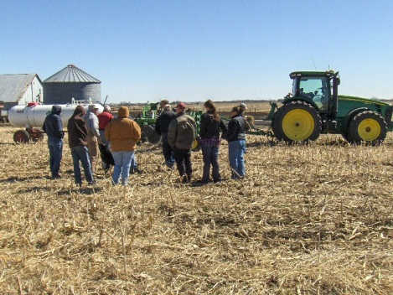
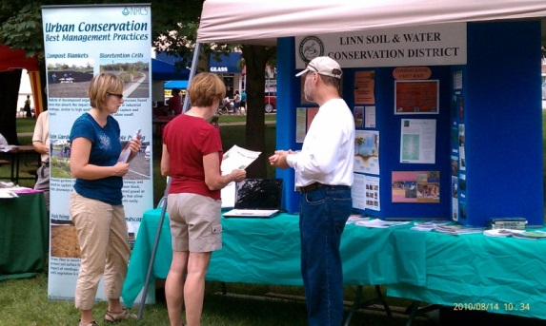
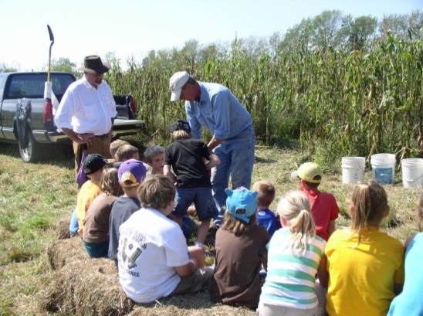
Rising to the Challenge: How? Promote Conservation
Lead by example, you are conservation role model
Help TRAIN & engage new staff in the office
“Spend a day with a farmer” is powerful
Participate in demo projects, expos, field days, workshops, tours, legislative events
Give presentations in your schools & community
Install signs; present awards
Write articles for print media, district newsletter, for your website or social media platforms
Give NACD’s Soil Health Champions a platform

Slide 26
Rising to the Challenge: Partners A 3-legged Stool
Soil and Water
Conservation
District
Local Level
5 elected Commissioners
District employees
District generated funding
LOCAL SOIL & WATER CONSERVATION DISTRICTS
State Level
Staff: Conservation Assistant & Technician
Funding
Federal Level
Staff: District, Resource & Soil Conservationists, Technicians, Biologists, Grazing Specialists, etc.
Funding
Office space, computers, telephones, vehicles, supplies, equipment

Slide 27
Partnership Agreements NRCS, IDALS and with each SWCD
Operate according to two primary agreements
Memorandum of Agreement
Describes locally led conservation delivery
Unfunded Cooperative Agreement
Purpose: Accelerate delivery of Farm Bill programs and enhance conservation delivery.
Identifies what NRCS provides in the field office (office space, computers, equipment, vehicles, etc.)
Note: Only commissioners & assistant commissioners are allowed to ride in Federal vehicles. No customers.

Slide 28
Rising to the Challenge: Other Partners
Core Partners
Conservation Districts of Iowa (CDI)
Iowa Department of Agriculture and Land Stewardship-Division of Soil Conservation and Water Quality (IDALS-DSCWQ)
USDA Natural Resources Conservation Service (USDA- NRCS)
State Soil Conservation and Water Quality Committee (SSCWQC) (Known as State Committee)
Other Partners
Other government agencies, academic institutions, environmental, nonprofit organizations, wildlife, hunting, commodity, service groups, agribusiness, landowners

Slide 29
Conservation Districts of Iowa:
Commissioners’ Association
1946: Iowa Association of Soil Conservation District Commissioners is formed and incorporated
Doing Business As: Conservation Districts of Iowa
A nonprofit 501(c)3 organization dedicated to representing & supporting commissioners and districts in their efforts
Funded by dues from districts, grants, contributions and administrative funds from partnership agreements
http://www.cdiowa.org

Slide 30
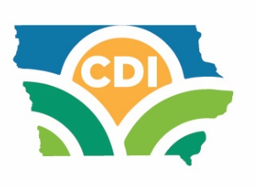
CDI’s Key Mission
Commissioner Support
Organize events for commissioners and offer
commissioner training and leadership opportunities
District Support
Resource for districts to find answers to key questions
Policy
Resolution process, support commissioner legislator outreach, annual legislative event, lobbyist, lobby at
state and federal level
Staff and board members represent CDI and districts at meetings and serve on national and state boards and project teams

Slide 31
CDI’s Key Mission (Cont’d)
Communications
CDI Connections, CDI Website, Commissioner Handbook,
Employer & Employee Handbook
Education & Acknowledgement
Poster Contest, Scholarships, Envirothon, Soil and Water Conservation Week and Awards
CDI Organizational Obligations
Office, budget, audit, grant management, payroll and other administrative tasks

Slide 32
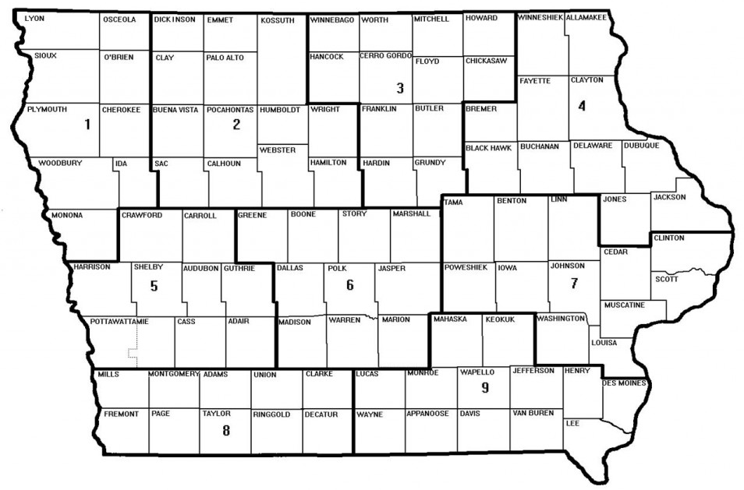
CDI Organization
Exec Board: President, VP, Past President, Secretary, Treasurer
9 Regions
Staff: 3 in state office and 12 in the field (NRCS Agreement)
1 Director & up to 2 Alternates elected per Region

Slide 33
Another Key Partner: National Association of Conservation Districts (NACD)
Began in 1946: Represented 1600 districts in 48 states.
Today, NACD represents America’s 3,000 districts &
17,000 commissioners.
NACD formed to deliver unified message on national policy especially the locally-led, voluntary incentive-based conservation model.
FARM BILL Title II- Conservation is a key focus this year.
Works through various partnerships, projects & programs to support districts, commissioners & staff
www.nacdnet.org

Slide 34
MOVING FORWARD TOGETHER WHAT’S NEXT?
What items/projects would you like CDI to work on?
www.cdiowa.org 515-289-8300

Slide 35
What’s needed?
What can CDI do to help you succeed as Commissioners?
www.cdiowa.org 515-289-8300

Slide 36
Thank you
Ramona Nitz, CDI President
Cindy Valin, Region 6 Director
Jack Boyer, CDI Treasurer
Jeri Thornsberry, CDI Vice President
Paul Ackley, CDI Secretary
Dien Judge, CDI Executive Director
www.cdiowa.org 515-289-8300

