Slide 1
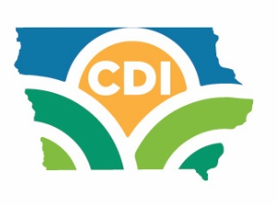
Soil & Water
Conservation District
Commissioner Orientation
Dien Judge, Executive Director
Conservation Districts of Iowa
February 5, 2025
Jeri Thornsberry, President
Eric Wessels, Vice President
Mary Ellen Miller, Secretary
Jack Boyer, Treasurer
Ramona Nitz, Past President

Slide 2
Housekeeping
Slide deck available on CDI website afterwards
Two Q&A opportunities—at the end of first hour and at the end of presentation
Put questions in Chat
Will take a 10-minute break
Evaluation form will be sent to CAs—Please fill out
Orientation first time on Zoom—We really want feedback!

Slide 3
Topic Outline
Story of Soil & Water Conservation
Understanding Your Elected Duties
Commissioner Responsibilities
Partnerships: Partner roles in supporting commissioners
National Association of Conservation Districts (NACD)
Conservation Districts of Iowa—Our Membership Association
Rising to the New Opportunities

Slide 4
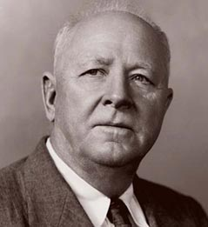
Story of Soil & Water Conservation
Father of Soil Conservation
Hugh Hammond Bennett
Born 1881 in Anson County, North Carolina on a 1200-acre cotton plantation
Graduated from University of North Carolina, specialized in geology and chemistry in 1903
Became a soil surveyor with the United States Department of Agriculture (USDA) immediately upon graduation
Hugh Hammond Bennett
1881-1960

Slide 5
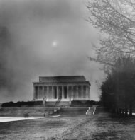
Story of Soil & Water Conservation
Soil Conservation Act
1935: Bennett presents to congressional subcommittee in favor of Public Law 46: The Soil Conservation Act
Bennett known for evangelical zeal; real showman
Timed presentation to congressional subcommittee to coincide with arrival of great dust storm in D.C.
“Gentleman, Get ready--here comes Oklahoma”
Passed by Congress, President FDR signed same year
Established Soil Conservation Service as permanent agency within USDA, now NRCS - Bennett first chief
First constitutional act in the history of this or any other nation that sought to control and prevent soil erosion, flooding, and other threats to natural resources

Slide 6

Story of Soil & Water Conservation
Iowa’s Story: Conservation Cost Share
1950: Iowa Legislature made available first tax money for conservation work
1973: Iowa becomes the first in nation to appropriate state cost share funds for conservation
2025: Cost share has been available for more than 50 years

Slide 7
Story of Soil & Water Conservation
SOIL LOSS: Iowa Legislation, First in Nation
1971: Legislation passed
  Establishes a soil loss limit
  Mandates soil conservation if a complaint is filed, and district and others determine soil loss is greater than established limits
  75% of mandated cost share be paid by IDALS cost share appropriations
  First law of its kind in the nation
1979: Legislation challenged
  Iowa Supreme Court finds law valid & constitutional

Slide 8

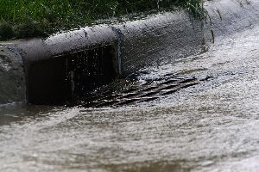
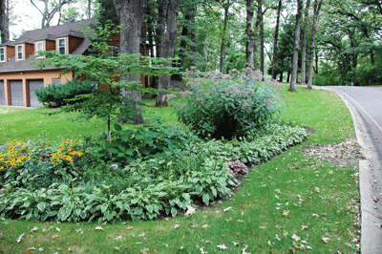
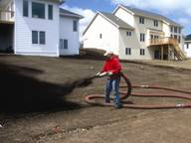
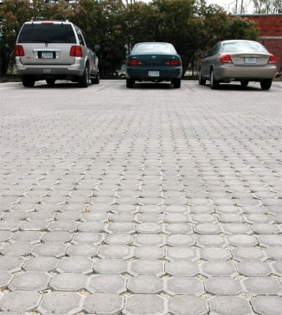
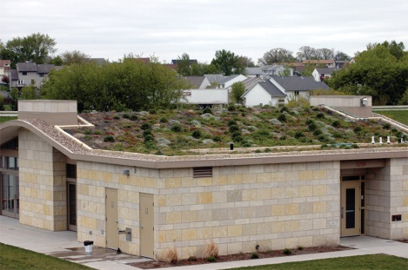
Story of Soil & Water Conservation
Urban Conservation in Iowa
1970: Amendment passes in Legislature— all Iowa cities & towns now included in soil districts & urban residents in each county could vote & could serve as commissioners
1997: NRCS creates Urban Conservationist position
2000: IDALS creates first Environmental Specialist position tasked with Urban Conservation responsibilities
2013 to present: REAP and Water Quality Initiative (WQI) rules allow for urban projects
URBAN POLLUTION
CONSERVATION SOLUTION

Slide 9
Understanding Elected Duties
Commissioners Protecting Iowa’s Natural Resources for 85 Years

Slide 10
Conservation Districts Defined
Local units of state government established under Iowa Chapter 161A to carry out soil and water programs at the local level
Five county elected nonpartisan officials for 4-year terms in staggered even numbered years—same as general election
Fiduciary responsibility for public funds
Protected from personal liability in the discharge of duties under State of Iowa bond
No compensation; reimbursed for authorized expenses as funding allows through Commissioner Expense Fund
Power to appoint assistant commissioners
Iowa Chapter 161A lists full scope of SWCD commissioner responsibilities

Slide 11
General SWCD Powers
Section 161A.7
READ EXPLANATION OF PARAGRAPHS IN CODE SECTION
A) research soil conservation (in cooperation with ISU)
B) conduct demonstrational projects (in cooperation with ISU)
C) carry out preventative and control measures
D) aid others in erosion-control, watershed protection, and flood prevention
E) acquire property, real or personal, to aid the district
F) make material/equipment available to assist landowners
G) construct, improve and maintain structures

Slide 12
More General SWCD Powers
Section 161A.7 (cont.)
H) develop comprehensive plans for the conservation of soil resources
I) sue and be sued
J) accept donations
K) change name (with approval of IDALS)
L) restore permanent conservation practices damaged by disaster emergency
M) help school districts teach about conservation
N) develop soil and water resource conservation plan (with IDALS and NRCS)
O) enter into agreements in carrying out water protection practices

Slide 13
Commissioner Responsibilities
Monthly Public Meetings
Agendas
Closed Session
Open Records/Open Meetings
Gift Law of Elected Officials
Conflicts of Interest
Five-year Plans
Annual Work Plan
Fiduciary
Commissioner Expense Fund
District Funds Sources
Resolutions Process

Slide 14
Public Meetings
Hold monthly public meetings; hybrid meetings OK Post notice of meeting with agenda 24 hours in advance
Conduct official business only with quorum of 3 commissioners
Abide by Iowa Open Meetings Law and Open Records Law
Maintain complete and accurate meeting minutes
Conduct meetings under standard parliamentary procedures

Slide 15
Agendas
Give 24 hours notice of the time, date, and place of each meeting
Identify all topics on which votes will be taken and matters that will be discussed.
Needed agenda detail will depend on the public’s familiarity with the matter. The less familiar the public is, the more detail is needed.
Stick to the posted agenda. If a new idea comes up at a meeting – either during public comment or while discussing another item – you may discuss, but action can only be taken on posted agenda items.

Slide 16

Closed Session - Chapter 21.5
Most common reasons
Discuss strategy with counsel in matters that are presently in litigation or where litigation is imminent
Evaluate professional competency if needed to prevent irreparable injury and the employee requests it
Closed sessions are serious business. Never ask the public to leave the meeting so the board can talk in private–unless the board has a legal basis to hold a closed session.
If information is discussed in closed session, the information is almost always confidential.

Slide 17

Open Records – Chapter 22
Applies to SWCDs
Lawful custodian is who currently has physical possession
Call IDALS (Will Myers (515.281.7818) when request is received
IDALS has a schedule of charges, time frame for response and other process steps
Some confidential record exceptions apply– certain personal identifying information cannot be shared
Do NOT have to answer questions or compile data
Do not ask why requestor wants information or what they intend to do with information

Slide 18

Gift Law for Elected Officials
Chapter 68B.22
Commissioners shall not accept gifts—receiving something for free or for less than it is worth—from a restricted donor.
Restricted donor - a party who purchases, leases or contracts to or from SWCD or will personally be directly and substantially affected by performance of donee’s official duty
Considered gifts: Money, Services, Loans, Travel, Entertainment, Hospitality, and Promises.
If you have a specific question, ask Ethics and Campaign Disclosure Board (www.iowa.gov/ethics) for guidance on gift law compliance.

Slide 19

Conflicts of Interest
Conflict AND potential conflict
Loyalty to the position vs. loyalty to private interest
Seek guidance if:
  (1) financial or other benefit to self or immediate family
  (2) being placed in a position that will subject him or her to conflicting duties
  (3) to act, or be tempted to act, in a manner other than in the best interest of the public
Recusal and disclosure or cease outside activity

Slide 20
Required Five-year Plans
NRCS funded a major effort to develop new 5-year plans for all 100 SWCDs. All districts 5-year plans are complete and recorded with your respective counties.
Updated 5-year plans are due again in 2026.
CDI employs professional planners to assist SWCDs with this process.
Activate the Federal Local Working Group process
Information in plans used to fulfill required reporting for EPA Nonpoint Source Management Plan.

Slide 21
District Annual Work Plan
Develop annual work plan using five-year plan as a starting point
Engage your Local Working Group including Watershed Management Authority groups to seek public input to add to plan
Identify major concerns in your county
Determine your objectives and goals for the year
Analyze all resource data you have available
Explore what activities will help you accomplish your goals
Be flexible, conditions may change
Share your annual plan publicly

Slide 22
Fiduciary Responsibility
Commissioners are fiduciaries.
A fiduciary is a person or organization that acts on behalf of another person or persons, putting the public interests ahead of their own, with a duty to preserve good faith and trust. Being a fiduciary requires being bound both legally and ethically to act in the other's best interests.
District funds are treated as public funds even though commissioners do not have direct financial authority over grant and conservation practice funds.

Slide 23
Fiduciary Responsibility (Cont.)
Review monthly treasurers' report during board meeting
Treasurer & Co-Treasurer date & sign report: “I verify I have reviewed the Treasurer’s Report & supporting Schedules.”
They also initial every page and document.
A motion is required to “accept the treasurer’s report as presented”
Follow your District Financial Policies
Conduct annual self-review of district funds; due by Sept. 30 to IDALS
Prepare and publish an annual report of accomplishments including financials

Slide 24
Commissioner Expense Fund
IDALS annual allotment (increased to $3,000 in Sept 2024 for FY 2025—first increase since FY21)
Pays mileage & allowed expenses for commissioners & assistant commissioners
CDI and NACD dues are paid from these funds, and also other association dues affiliated with our mission
Can buy office supplies & pay for printing of publications
Cover meeting & workshop expenses—no food/drinks
More allowed expenses are found in IDALS Policy & Procedures Manual, available from your CA.

Slide 25
OVERVIEW: District Funds Sources
District funds are public funds
In FARMS (Financial And Resource Management System)
All practices receiving state cost share, DNR 319, WPF, WSPF, WQI, no interest and low interest loans
In District Account
Commissioner Expense Fund
Funds from District fundraising activities (tree sales, equipment rental, donations, etc.) Spend with commissioner discretion according to district policy
Funds from grants such as DNR 319, WPF, WSPF, & WQI for admin including salary, benefits, education and outreach, supplies, equipment, travel and training, etc. Monthly requests for these funds required for reimbursements or advances.
NRCS Systems
(ProTracts/Conservation Desktop)
All contracts receiving federal cost share: EQIP, CSP, RCPP, etc.
CRP contracts managed by Farm Service Agency (FSA)

Slide 26
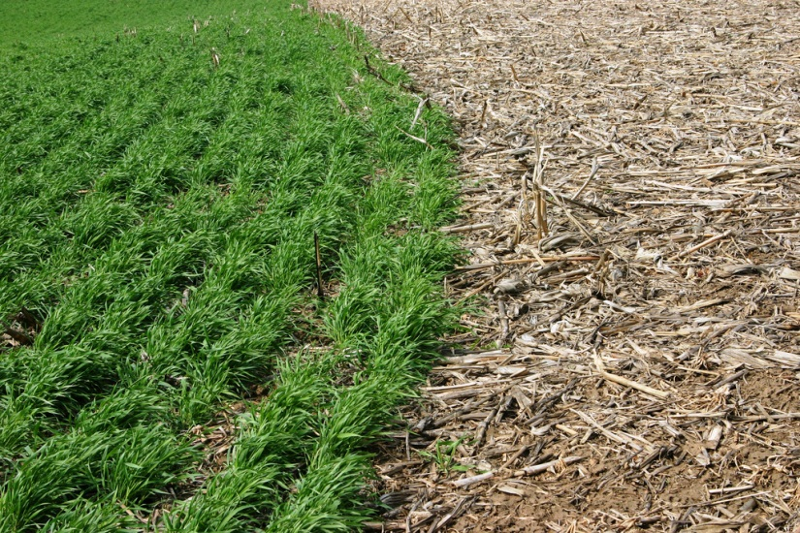
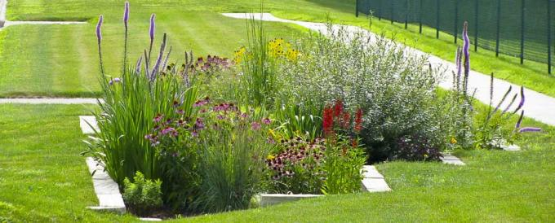
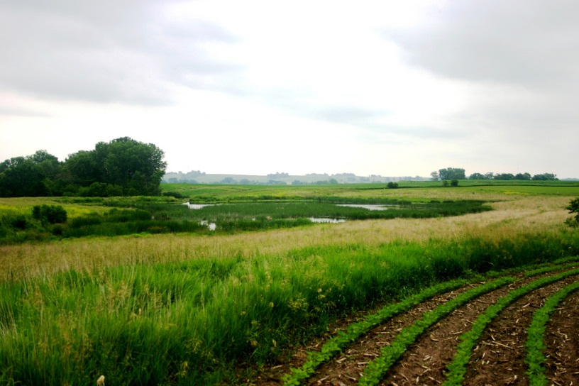
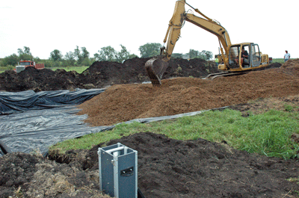
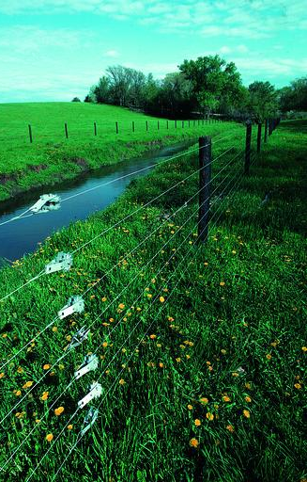
Conservation Outreach
Get practices on the land to conserve soil and water
Cover Crops
No Till
Rain Gardens
IDALS
www.forevergreengrows.com/landscaping
Wetlands
Bioreactors
Pasture Mgmt
IDALS
NRCS
NRCS

Slide 27
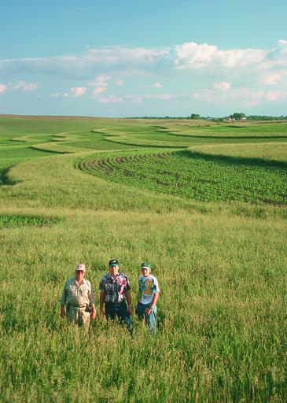
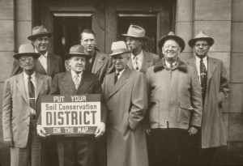
Conservation Outreach
Tell the story of conservation
NRCS

Slide 28
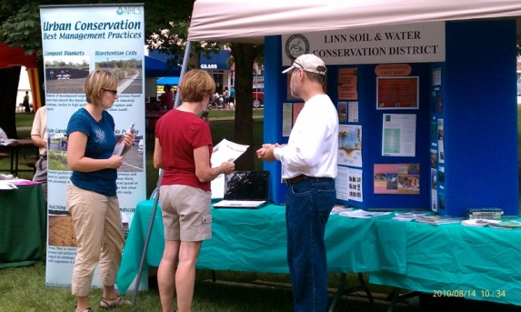
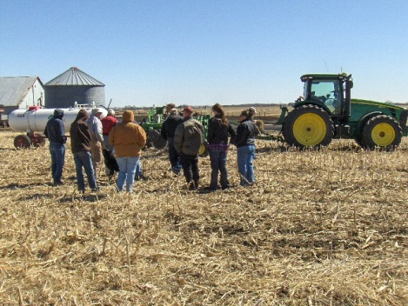
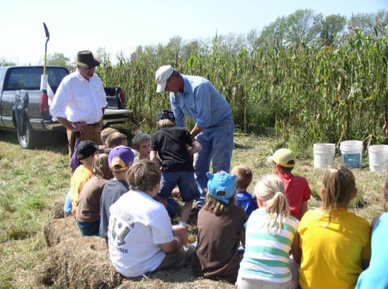
Conservation Outreach
Be a vocal advocate, promote conservation
Lead by example, you are conservation role model
Help TRAIN & engage new staff in the office
“Spend a day with a farmer” is powerful
Participate in demo projects, expos, field days, workshops, tours, legislative events
Give presentations in your schools & community
Install signs; present awards
Write articles for print media, district newsletter, for your website or social media platforms
Give NACD’s Soil Health Champions a platform

Slide 29
Resolutions Process
Commissioners are empowered to affect change in administrative rules, policy, or law
Resolutions address a problem in your district that CDI should act upon, challenge, or propose a change to IDALS administrative rules, or suggest a change or improvement in the Farm Bill or other federal programs
If a district believes that a policy change is needed, they submit their idea to CDI as a resolution and fellow commissioners vote on that resolution at Annual Conference
Each year CDI provides detailed resolution process instructions

Slide 30
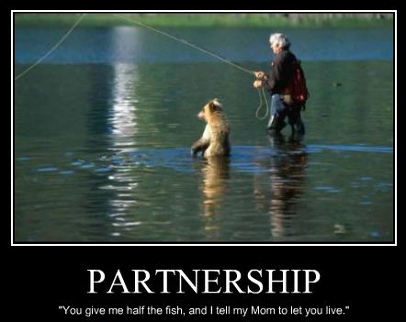
Partnerships
…you don’t have to go it alone!

Slide 31


Core Partners in Conservation
Local Level
5 elected Commissioners
Staff: District employees
Generates District funding
Soil and Water
Conservation
District
SOIL & WATER CONSERVATION DISTRICTS
State Level
Staff: Conservation Assistant & Technician
Provides Commissioner Expense Funding
Awards State Grants
Federal Level
Staff: District Conservationists, Soil Technicians, Biologists, Grazing Specialists, etc.
Awards Federal Grants
Provides office space, computers, telephones, vehicles, supplies, equipment

Slide 32
Partnership Agreements
Between NRCS, IDALS & each SWCD
Operate according to two primary agreements
  Memorandum of Agreement
    Describes locally led conservation delivery
  Unfunded Cooperative Agreement
    Purpose: Accelerate delivery of Farm Bill programs and enhance conservation delivery.
    Identifies what NRCS provides in the field office (office space, computers, equipment, vehicles, etc.)
Note: Only commissioners & assistant commissioners are allowed to ride in Federal vehicles. No customers.

Slide 33
Variety of Supporting Relationships
Other Relationships
  Conservation Districts of Iowa (CDI)
  State Soil Conservation and Water Quality Committee (SSCWQC) (Known as State Committee)
  Iowa Department of Natural Resources (DNR)
  Environmental Protection Agency (EPA)
  US Army Corps of Engineers
  Many others: governmental agencies, academic institutions, service groups, landowners, nonprofit organizations: environmental, wildlife, hunting, commodity, agribusiness

Slide 34

National Association of
Conservation Districts (NACD)
Began in 1946 representing 1600 districts in 48 states.
Today, NACD represents America’s 3,000 districts &
17,000 commissioners.
NACD formed to deliver unified message on national policy especially the locally-led, voluntary incentive-based conservation model.
FARM BILL Title II - Conservation is a key focus this year.
Works through various partnerships, projects & programs to support districts, commissioners & staff
www.nacdnet.org

Slide 35

Conservation Districts of Iowa
Our Membership Association
1946: Iowa Association of Soil Conservation District Commissioners is formed and incorporated
Doing Business As: Conservation Districts of Iowa
A nonprofit 501(c)3 membership association dedicated to representing & supporting commissioners in their efforts
Funded by dues from districts, donations, and administrative funds from partnership grant agreements
www.cdiowa.org

Slide 36
CDI’s Mission and Function
Mission
Conservation Districts of Iowa informs, educates and leads Iowans through our local soil and water conservation districts to promote conservation of natural resources.
Function
Conservation Districts of Iowa supports the soil and water conservation districts through public education, acknowledgement, commissioner development, policy, on-the-ground conservation, conservation practice promotion, events and more.

Slide 37
CDI’s Structure
Structure
500 Soil and Water Conservation District commissioners
- Five commissioners per 100 soil & water conservation
districts make up the membership of CDI
Day-to-day operations of CDI are governed by:
  - Executive Committee
  9 Regional Directors
  First and Second Alternate Directors
Each of 9 Regional Directors represents 9-13 SWCDs

Slide 38
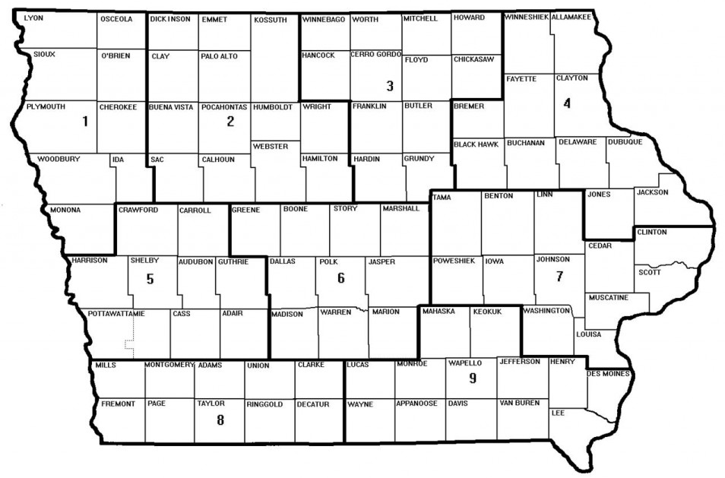
CDI Regional Map
9 Regions
Executive Committee: President, VP, Past President, Secretary, Treasurer
Staff: 2 in state office and 38 in the field (NRCS Agreement)
1 Director & up to 2 Alternates elected per Region

Slide 39
CDI CDI Membership Benefits
Commissioner Orientation and Education
  Biennial Commissioner Orientation Program
  Continuing Education: Spring Regional Meetings, Conservation Partnership Day at the Capitol, Annual Conference
Support Services
  Resource for districts to find answers to key questions
  Commissioner Handbook
  Employer & Employee Handbooks
  Additional educational resources on website
  Liaison to IDALS and NRCS for SWCDs
Communications
  CDI Website www.cdiowa.org
  CDI Connections Monthly Newsletter
  Social Media
  Legislative Updates

Slide 40
Membership Benefits (Cont.)
Policy Development and Advocacy
  Resolution process to influence state and federal policy/programs
  Support commissioner legislator outreach
  Organize annual legislative event at Capitol
  Hire lobbyist for state level issues
  Executive Director lobbies at state and federal level; Farm Bill key ask
  Staff and board members represent CDI and Districts at Regional meetings and serve on National, Regional and State boards and project teams

Slide 41
Membership Benefits (Cont.)
Public Outreach
  Poster Contest
  CDI Sponsored Scholarships
  Envirothon
  Soil and Water Conservation Week
  Annual Recognition Awards
Organization Management
  Commissioner Support
  Grant Negotiation and Management
  Executive Director, Program Manager, 2 Planning Coordinators, and 25 Administrative Support Specialists
  5 Conservation Wetlands Specialists, 5 Land and Water Conservation Specialists, 5 Wetland Engineering Specialists,

Slide 42
CDI Regional Directors and Alternates
Region 1 – Robert Ladd, Director; John Kooiker, 1st Alt.; Steve Tonsfeldt, 2nd Alt.
Region 2 – Perry Black, Director; TC Loving, 1st Alt.; Luke Snyder, 2nd Alt.
Region 3 – Allen Kadolph, Director; John Oltman, 1st Alt.
Region 4 – Sean Dolan, Director; Rick Matt, 1st Alt.; Wayne Demmer, 2nd Alt.
Region 5 – Pete Hobson, Director; Daryl Nelson, 1st Alt.; Phil Kading, 2nd Alt.
Region 6 – Cindy Valin, Director; Mike White, 1st Alt.
Region 7 – Mike Phillips, Director; Kent Stuart, 1st Alt.
Region 8 – Darwin Hanson, Director; Paul Ackley, 1st Alt.
Region 9 – Jeff Olson, Director; John Sellers, 1st Alt.; Alica Bales, 2nd Alt.

Slide 43
CDI Executive Committee
Jeri Thornsberry, President
Eric Wessels, Vice President
Ramona Nitz, Past President
Mary Ellen Miller, Secretary
Jack Boyer, Treasurer
www.cdiowa.org 515-289-8300

Slide 44
Upcoming Events
Spring Regionals begin February 25 to Feb 27
and continue March 4 to 6. CAs have schedule
79th CDI Annual Business Meeting & Conference
    August 25 and 26, 2025
    Gateway Hotel & Conference Center in Ames
    IDALS pays Hotel & Registration
    Mileage paid by Districts

Slide 45

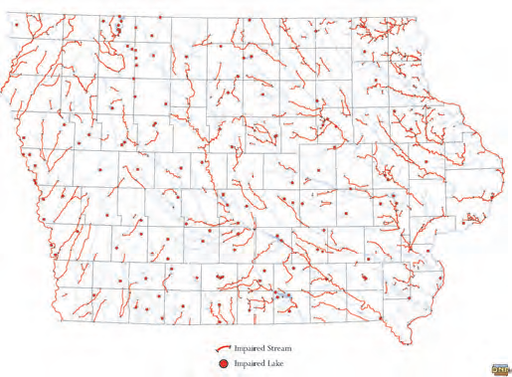
Rising to New Opportunities
Why?
Variable weather patterns
Increase in population-more pressure on the land
Soil losses
Nearly 600 of Iowa’s streams, rivers & lakes are impaired or highly polluted, contributing to Dead Zone in Gulf of Mexico
Over 50% of land in Iowa is rented
Decrease in governmental resources
More non-traditional partners

Slide 46
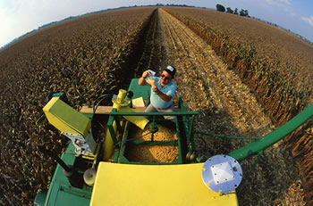
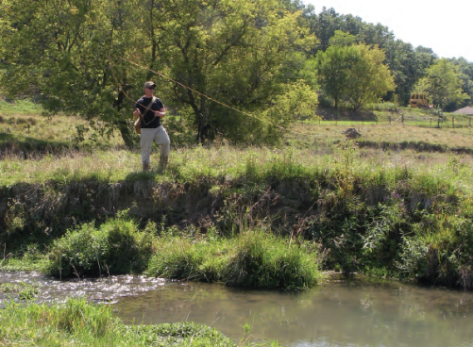
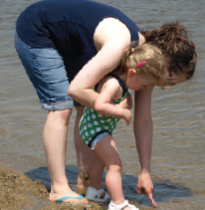
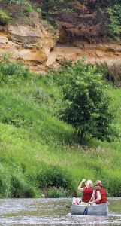
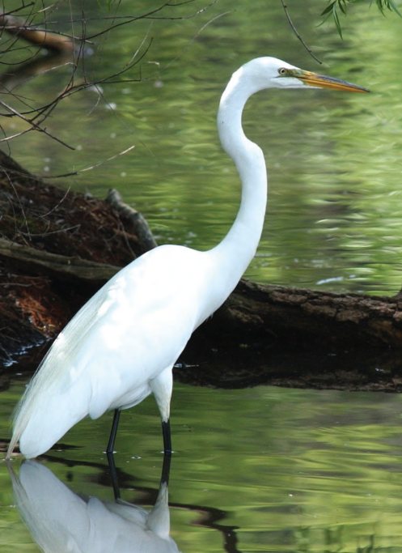

Rising to New Opportunities
Why conserve Iowa’s soil & water?
Protect agricultural industry in Iowa
Protect tourism industry and quality of life for Iowa’s visitors and Iowans
For Iowa’s natural heritage, plants, fish & wildlife
For Iowa’s future, children
ISU
DNR

Slide 47
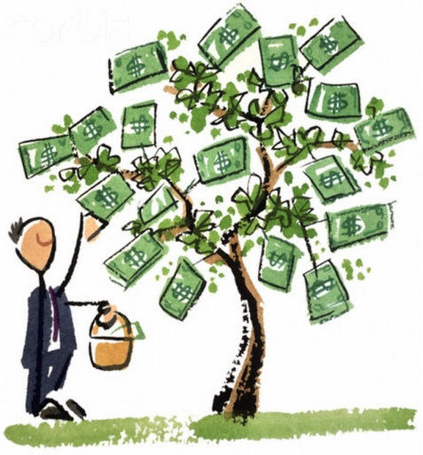
Rising to New Opportunities
Funding Sources
Provide financial assistance
Tap into existing federal and state available funding
Manage Grants
Accept donations
Fundraisers (tree and flower sales, sell ads in newsletters, etc.)
Acquire property, receive income from property
Purchase soil conservation equipment and rent to landowners

Slide 48
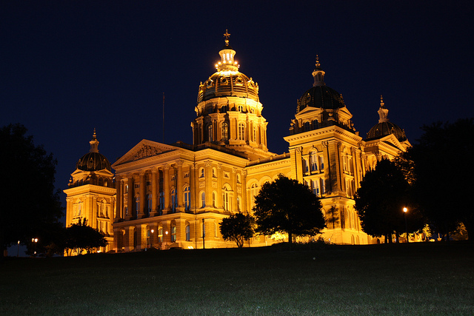
R Rising to New Opportunities
Policy Engagement
Call, e-mail and mail letters to your legislators
Invite legislators to commissioner meetings and district activities
Hold a legislative meeting, tour of the office for legislators
Attend the annual commissioner legislative event in Des Moines, Iowa Conservation Partnership Day
Cultivate a relationship with your legislators

Slide 49
L Leave a Legacy of Your Work
“If we were truly driven by the need to feed the world, we would be cognizant of the long term need to maintain soil and water resources so that we could sustain our noble intent.”
Richard Cruse, Agronomy Professor, Iowa State University

Slide 50
What’s needed?
Call CDI
CDI Executive Director
      Dien Judge
      (515) 289-8300
      www.cdiowa.org

